Slide 1
Progressive Web Apps
Mohan Ram.H.R

Slide 2
Agenda
What is PWA?
Why PWA?
Core tenets of PWA
Hands on

Slide 3
What is PWA?
A Progressive Web App uses modern web capabilities to deliver an app-like user experience.
They are installable and live on the user's home screen, without the need for an app store.
Notes:
On the whole, Progressive Web Apps describe a collection of technologies, design concepts, and Web APIs that work togather to provide an app-like experience on the mobile web. Let’s walk through some of the core tenets of Progressive Web Apps.

Slide 4
Why PWA?
App like experience
Push notifications
Working offline
Adding as icon in home screen
URL - https://whatwebcando.today/

Slide 5
Core tenets of PWA
Service Workers
They power offline functionality, push notifications, background content updating, content caching etc
App Shell
Simple design concept to define the application initial load to initiate the application.
App Manifest
Helps to install/add application to home screen via install banners

Slide 6
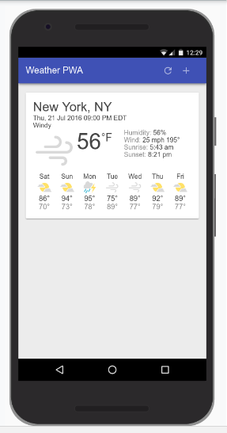
Hands on
What you'll learn
How to design and construct an app using the "app shell" method.
How to make your app work offline.
How to store data for later offline use
URL -https://developers.google.com/web/fundamentals/getting-started/codelabs/your-first-pwapp/

